Slide 1
Roots of American Democracy
50+ videos Play all Play now Mix - Too Late to Apologize: A Declarationby YouTube

Slide 2
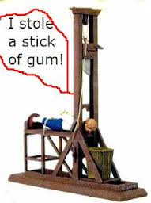
Early non- British Influences
Code of Hammurabi – Babylonian King, Hammurabi,
created the first written legal code
harsh punishments
applied to everyone
Draconian Law – Athenian
(ancient Rome)
law that was very
harsh-punishment death.
.

Slide 3
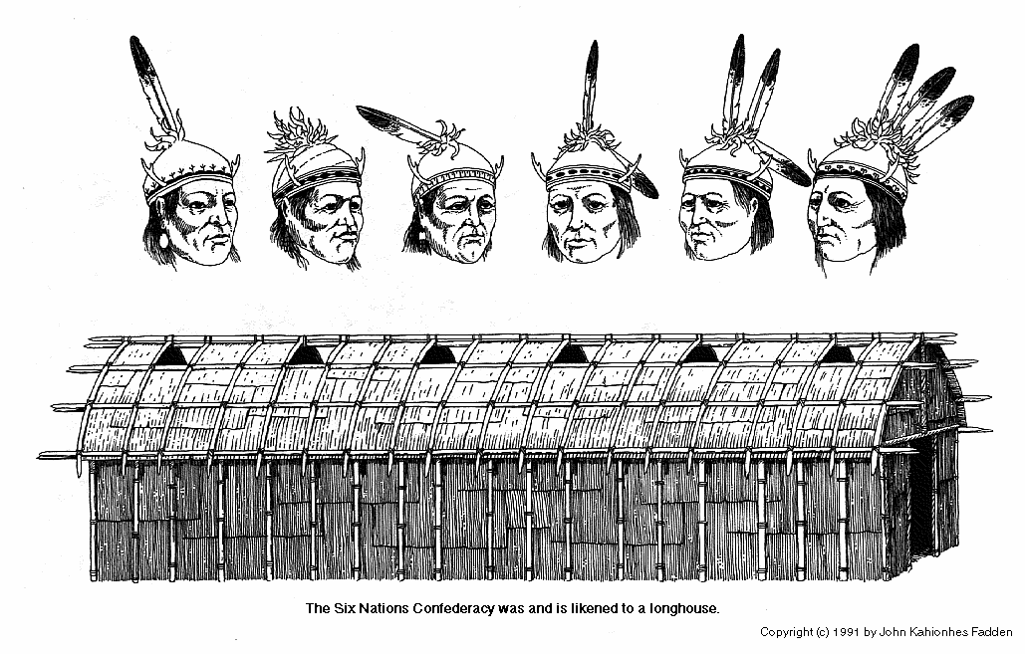
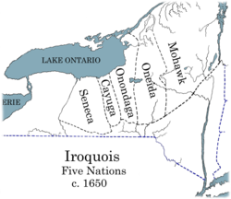
Justinian Code –Byzantine emperor Justinian I created a collection of past legal laws.
Iroquois National Confederacy- oral constitution between 5 Native American Tribes established a confederacy of nations and participatory government. Women played a very powerful role
Democracy - unanimous votes were required for a decisions

Slide 4
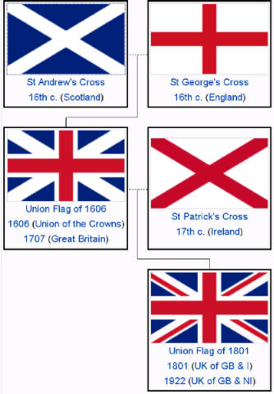
British Influences
Magna Carta 1215 : limited the power of the King
Glorious Revolution 1688: Limited the King’s power – Parliament’s power increased
English Bill of Rights 1669: Parliament power; basic rights of citizens
Common law: system of law based on precedent: a ruling in an earlier case that was similar (also traditions)

Slide 5
Impact of
The Enlightenment 1600’s – important because new philosophical and political ideas were created. It stressed the use of reason & scientific method

Slide 6
John Locke 1632-1704
He believed people are born with “natural rights.” Life, Liberty and Property.
These natural rights are rights that government does not have the right to take away.
Social Contract Theory – people born with freedoms they give up for the common good and civic virtue (acting in ways that are better society rather than self interest)
If a government does not honor and protect those rights – the government should be replaced

Slide 7
Montesquieu 1689-1755
Separation of powers: power should not be in the hands of one or a few
- rather in the hands of many
Checks and balances: the concept that by limiting government’s power by requiring that power be balanced among the different governmental institutions creates balance.
These institutions continually check one another’s activities. Power against power.
If government does not do its job then in should be replaced

Slide 8
Voltaire (1694-1755)
Believed in freedom of speech, expression and religion
Jean Jacque Rousseau 1712-1778 Believed “all men are created equal”

Slide 9
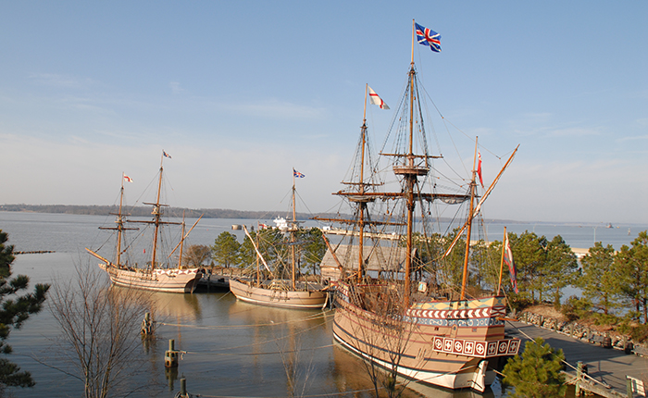
Colonies in the New World
Jamestown (Virginia): 1st permanent English settlement in New World ( Dig for Va.)
Joint-Stock Companies: provide money to finance trip, expect profits in return
House of Burgesses : 1st representative democracy

Slide 10
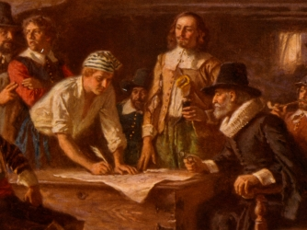
Plymouth Colony (Massachusetts): founded by Pilgrims, 2nd permanent English Colony (Separatists/Puritans), left for religious freedom
Mayflower Compact: direct democracy; town meetings

Slide 11
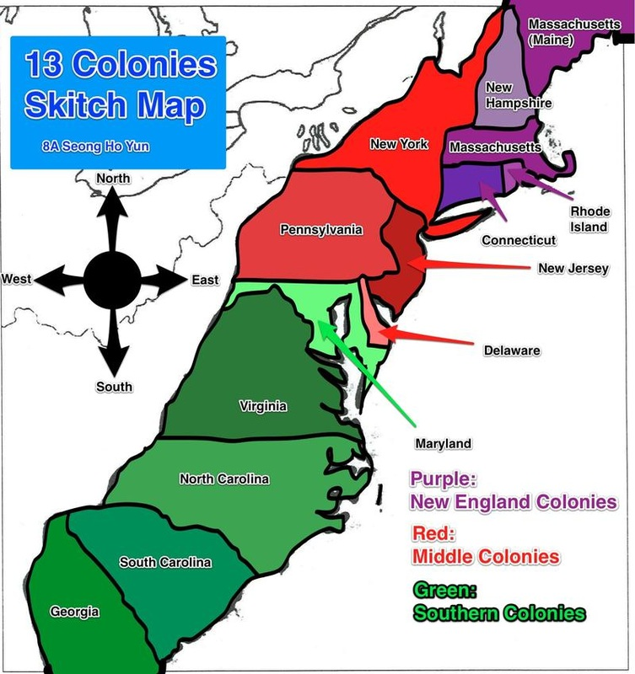
Types of Colonies
Proprietary Colony – ruled by 1
Royal Colony – ruled by King
Self-Governing Colony –
ruled by the people
UNIT I: ESTABLISHING THE 13 BRITISH COLONIES - WSMS 8th US HISTORY
sites.google.com618 × 800Search by image
Life in the English Colonies

Slide 12
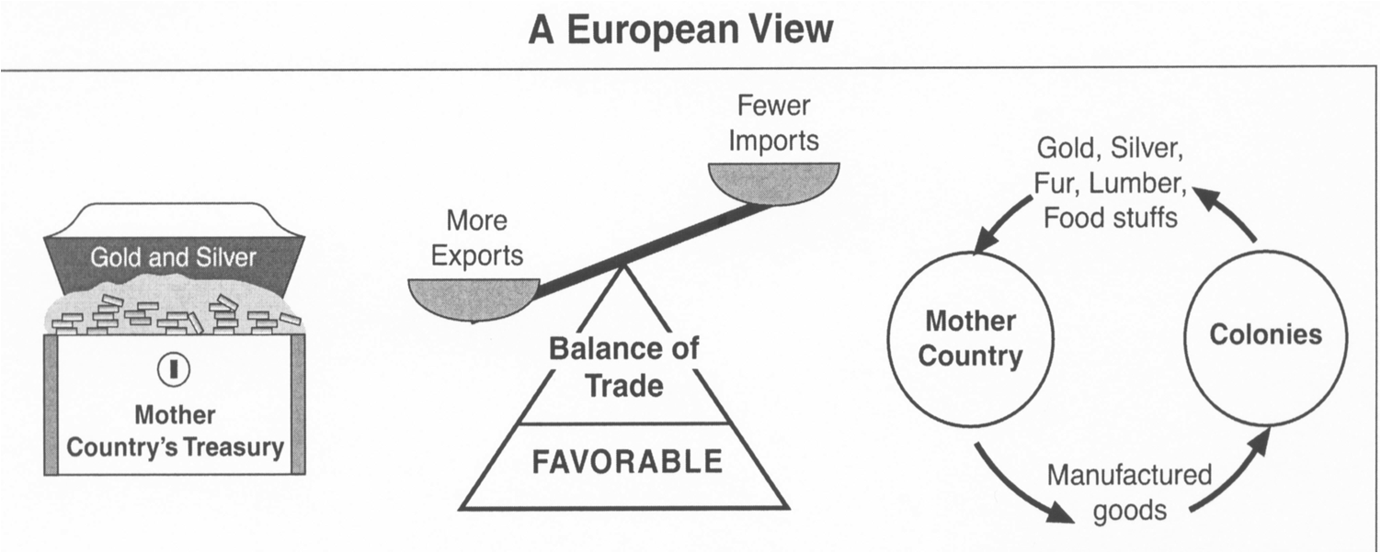
Mercantilism: country should sell more goods to other countries than it buys
Colonies were seen as a good source of cheap materials for G.B.
Middle Passage: slaves from Africa

Slide 13
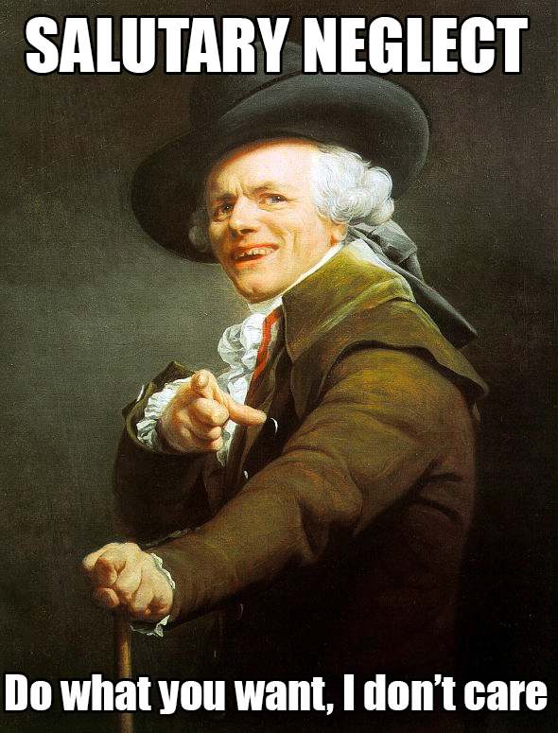
Road to Independence
An Emerging Identity
1.The colonists were British citizens who lived as Americans. They build their own homes and learned how to handle their own problems
2. After years of being left alone by Britain (salutary neglect), tensions grew once Parliament began to take an active interest in the colonies. (taxing, creating trade laws, etc.

Slide 14
Relations with England
Salutary Neglect: England ignores Colonies (become self-sufficient & self-governing)
French and Indian War:
England (w/ colonies) vs. France (w/ Indians)
England wins control over France’s territory in New World
Treaty of Paris 1763 ended the French and Indian War
British debts led to heavy taxes on colonies

Slide 15
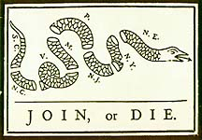
Albany Plan of Union: began unifying colonies; Ben Franklin- Join, or Die (also used in Rev. War)
“no taxation without representation”

Slide 16
Proclamation of 1763: colonists may not expand past Appalachian Mtns.
Writs of Assistance 1761 : British officers can enter and search property (led to 4th Am.)
Stamp Act 1765 : paper/playing cards
Townshend Acts 1767 : paint, cloth, glass etc.

Slide 17
Boston Massacre: March 5, 1770
propaganda Cristpus Attucks -first deaths of revolution and 5 more townspeople
Tea Act 1773 May 10 : monopoly for English tea company
Boston Tea Party December 16, 1773

Slide 18
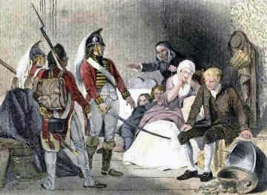
Intolerable Acts 1774-closed Boston Harbor; included
Quartering Act 1775- must house soldiers
led to 3rd Am) and trials for soldiers in England

Slide 19
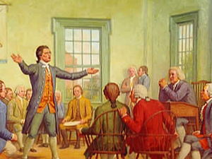
1st Continental Congress 1774 :
protest Intolerable Acts
formed Committees of Correspondence
King responded with violence = Lexington and Concord – 1st battle of Rev.

Slide 20
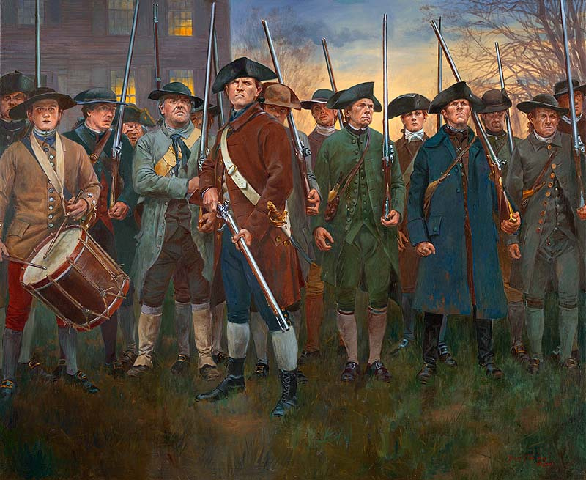
Revolutionary War: Lexington/Concord (“Shot Heard Round the World”); French aid; Yorktown (end); Treaty of Paris 1783

Slide 21
Declaration of Independence July 4, 1776
– Thomas Jefferson
Common Sense Jan – Feb 1776 – by Thomas Paine was a pamphlet that explained why it was common sense that the colonies should call for independence from Britain.
2nd Continental Congress summer of 1775– began to write the Articles of Confederation; organize for war; sign the Declaration of Independence.

Slide 22
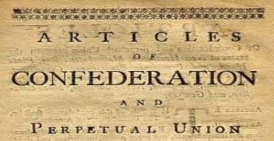
November 15, 1777 – Articles of Confederation were adopted by the Continental Congress .
This document served as the United States' first constitution, and was in force from March 1, 1781, until 1789 when the present day Constitution went into effect.

