Slide 1
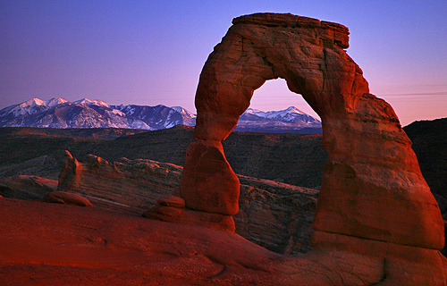
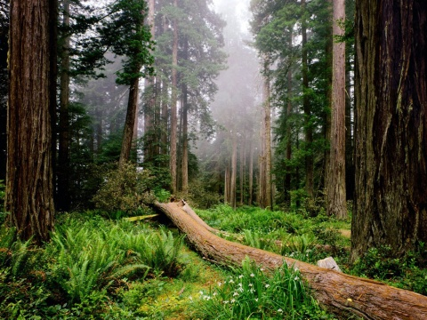
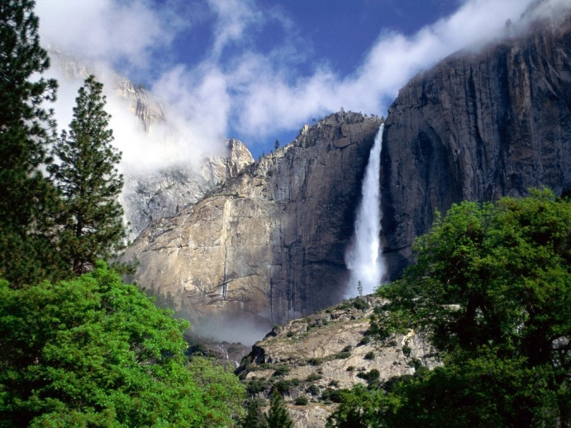
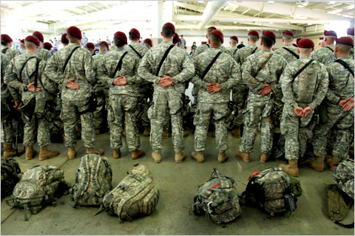
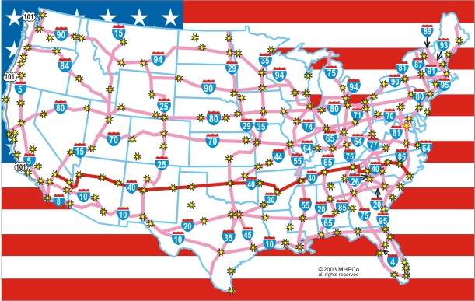
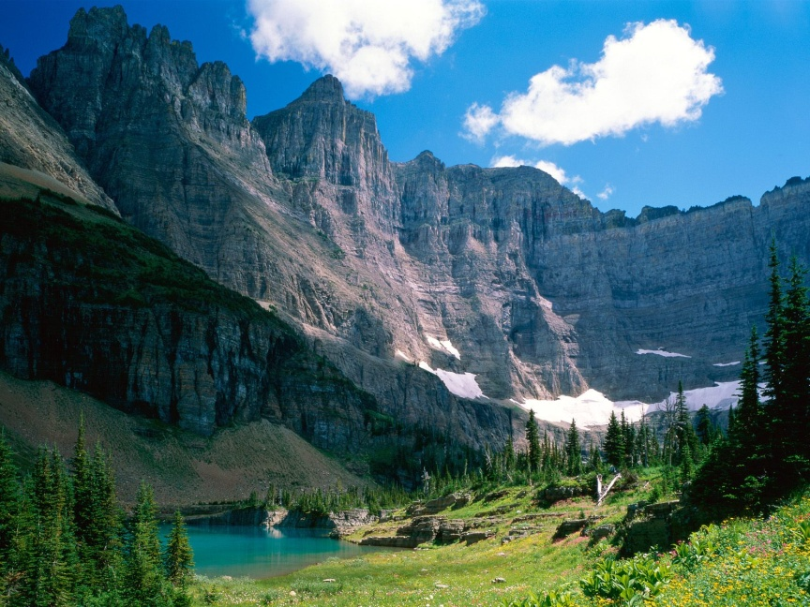
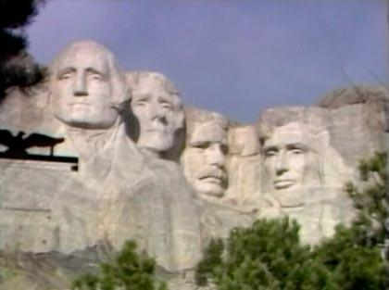
Yomsemite
Utah
Government Spending and Taxing
How government spends its money
Public goods and services
Federal government services
Interstate Highways
Federal Courts
Military
Social security
National Park&/Forests

Slide 2
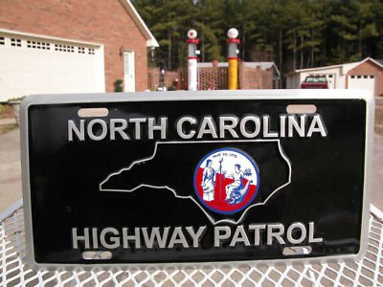
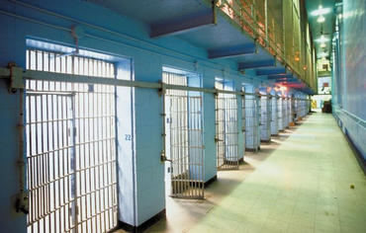
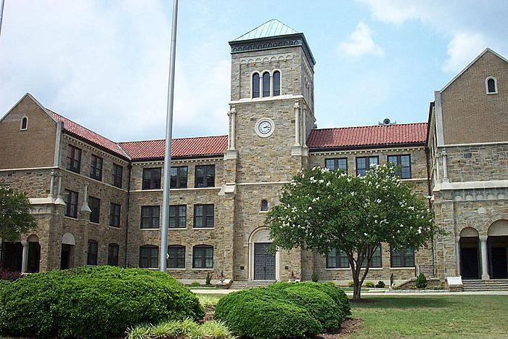
State government services
Prison Systems and State Courts
Highway Patrol
State Parks
Education – number one expense
Local government services
Public Education
Public Safety

Slide 3
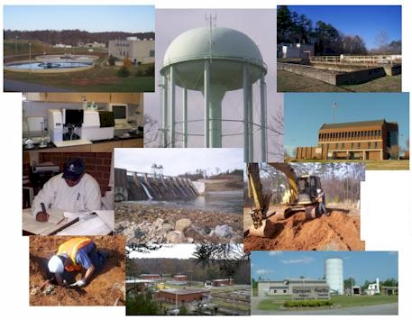
Public Utilities

Slide 4
B. Federal Budget Process
Types of budgets – Fiscal Year: the 12 month time period for a budget.
The governmental budgets starts in the fall:
balanced budget: revenues equals expenditures
Revenue: Taxes, fees, social security, bonds
Expenditures: Social programs, defense, military, courts, high ways, parks, museums, infrastructure
surplus budget: revenues exceed expenditures
Revenue: Taxes, fees, social security, bonds
Expenditures: Social programs, defense, military, courts, high ways, parks, museums, infrastructure
deficit budget: expenditures exceed revenues
Revenue: Taxes, fees, social security, bonds
Expenditures: Social programs, defense, military, courts, high ways, parks, museums, infrastructure

Slide 5
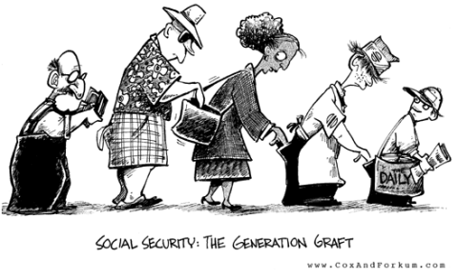
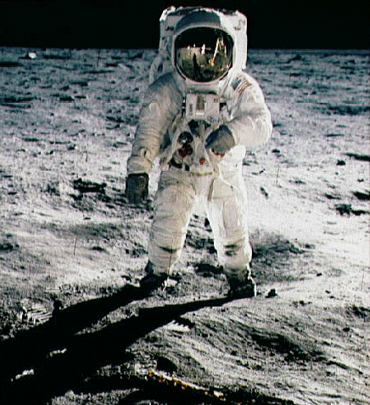
Types of Spending
Mandatory Spending: Money that must be spent.
ex. social security benefits discretionary spending
Discretionary Spending : Money that is optional to spend.
ex. Space exploration or coast guard

Slide 6
Process
Prepared by chief executive with assistance from the budget office
Sent to Congress or Legislature (State) for debate and approval
C. Taxes/Government Spending
1.Principles of taxation
a. Benefit principle: the principle that those who benefit from a government
program should pay the taxes to finance the program
Ex. Gasoline tax to fund roads
Who uses the roads?

Slide 7
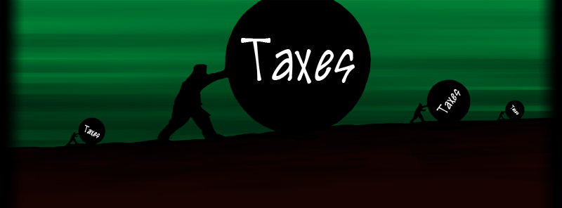
b. ability-to-pay: principle of taxation based on the assumption that those most able
to pay taxes should pay the most taxes.
The more you make the more you pay.

Slide 8
2. Classification of taxes
a. Proportional: a tax that takes a constant percentage of income as income rises
Progressive: a tax that takes an increasing percentage of income as income
rises.
Example: Federal income tax
c. Regressive: a tax that takes a decreasing percentage of income as income rises
Example: Sales Tax
(Ms. Regi’s) Golden Rule: In order to understand the 3 tax classifications, YOU must compare the percentage of a person’s income paid in taxes NOT the dollar amount each person spends on taxes.

Slide 9
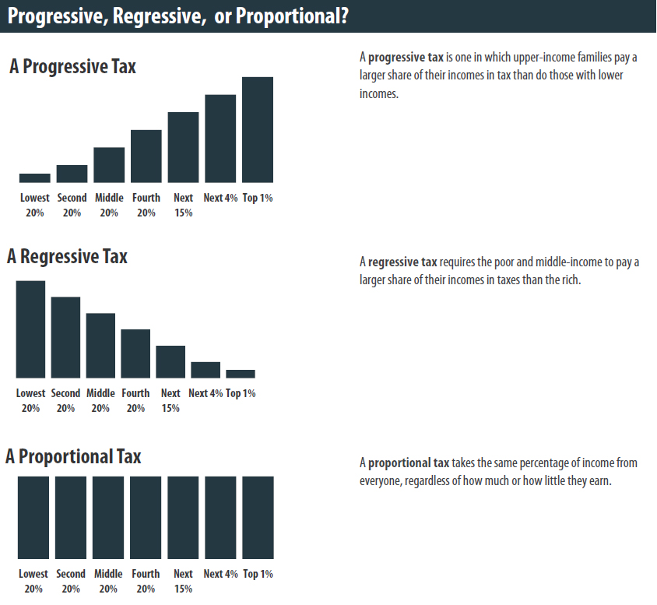

Slide 10
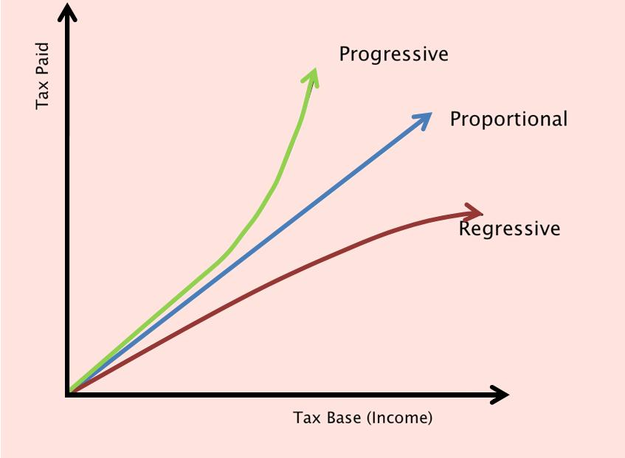

Slide 11
Proportional or FLAT TAX: a tax that takes a constant percentage of income as income rises
= $ 1,000
Does proportional exist in the U.S.?
10,000 10% = 1,000
20,000 10%= 2,000
100,000 10%= 10,000
1,000,000% 10%= 100,000

Slide 12
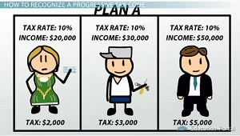
Proportional Tax

Slide 13
Progressive: a tax that takes an increasing percentage of income as income rises.
Example: Federal income tax
Budget Project Income Tax example :
Less than $20,000: 15%
$20,000 – $29,999: 20%
$30,000 – $39,999: 25%
$40,000 - $59,999: 30%
Above $60,000: 35%

Slide 14
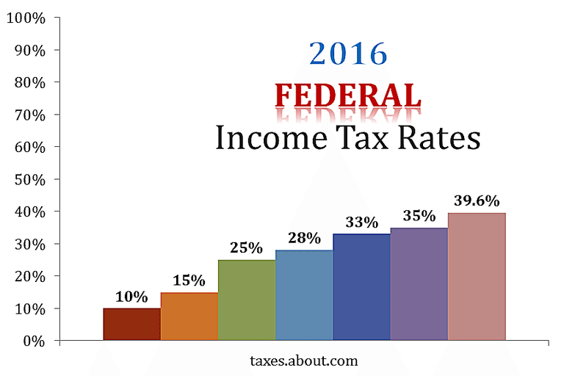
PROGRESSIVE TAX BRACKETS
Tax Planning in the U.S.
Federal Income Tax Rates for the Year 2016
Federal Tax Rates Can Apply to Different Income Thresholds Each Year
By William Perez
Updated January 27, 2017

Slide 15
Regressive: a tax that takes a decreasing percentage of income as income rises.
The more you make the less you pay.
Sales Tax Example
Two people each buy a car for
$10,000 car.
$10,000.00 price
+ $800.00 sales tax .08%
$10,800.00 Total
Walmart Greeter:
Salary 10,000
The $800.00 is 8% percent of the person’s total income .
Partner in a law fim:
Salary $300,000.00
$800.00 is .002 % of the person’s total income. It is not 1% the person’s total income.

Slide 16
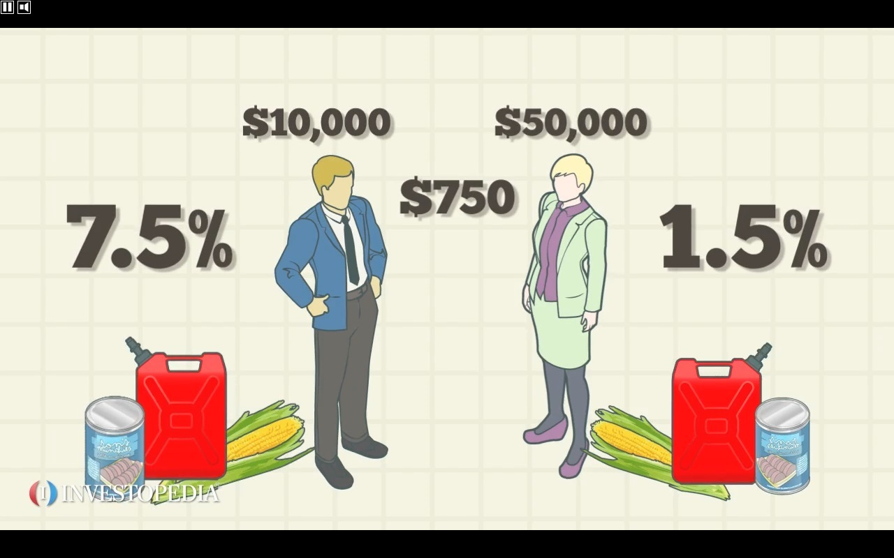
Regressive Tax

Slide 17
Regressive Tax

Slide 18
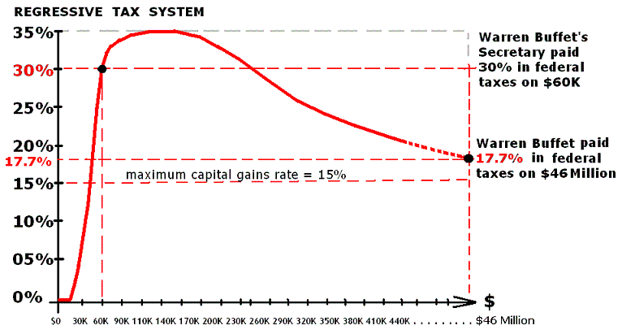

Slide 19
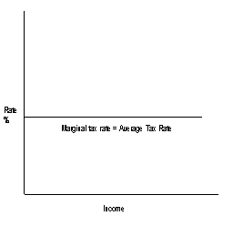
North Carolina’s income tax rate 5.49%
5.49%
$10,000
$100,000,000

Slide 20
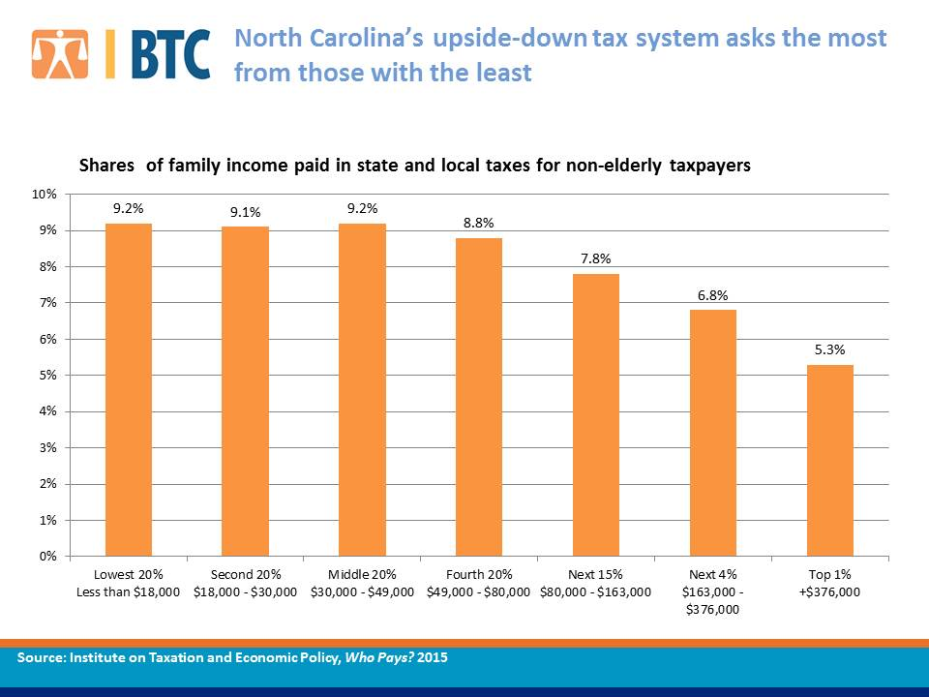
There is a difference in tax brackets and actual percentage in income paid.
Institute on Taxation and Economic Policy, Who Pays? 3rd Edition.

Slide 21
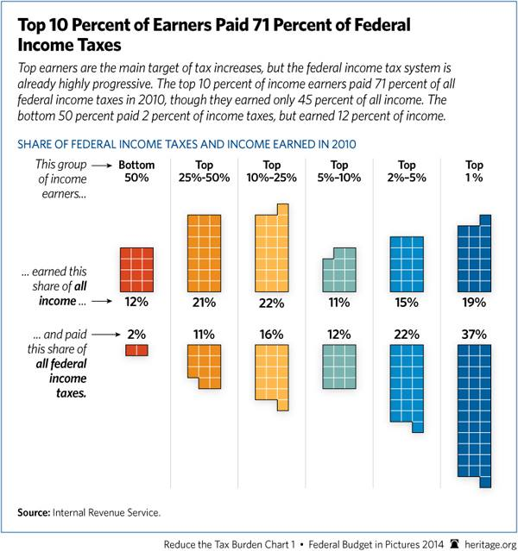

Slide 22
D. The American Tax System
Federal and State individual income tax:
- a tax on the money an individual earns
- largest source of revenues
Social security taxes:
federal insurance, financed by a special tax, that provides benefits for people who are retired
payroll tax
second largest source of federal revenues

Slide 23
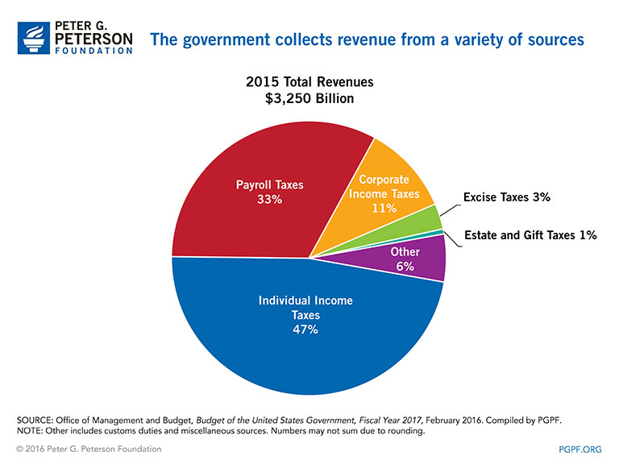

Slide 24
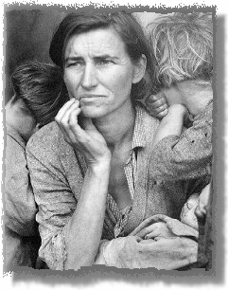
During the Great Depression:
Two million adult men ("hobos")
25% of population unemployed
A woman in South Carolina scrawls a note to a man in Washington whom she addresses as "Dear Mr. President." "I'm 72 years old and have no one to take care of me." Another letter comes to the White House from Virginia. "I'm a 60 year-old widow greatly in need of medical aid, food and fuel, I pray that you would have pity on me." Letters such as these came by the thousands from old folks across the country to the President, to Mrs. Roosevelt, to almost every one in Washington whose name was familiar to them.
Typical Letter to President Roosevelt, Appealing for Old-Age Pensions
This classic photo of a Depression-era family captured the anguish of the times. Photo by Dorothea.

Slide 25
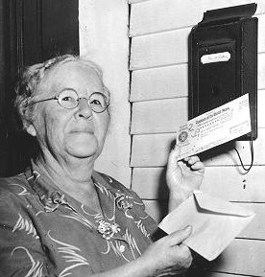
Monthly Benefits
The Social Security Act was signed into law by President Roosevelt on August 14, 1935.
Payment of monthly Social Security benefits began in January 1940, and were authorized not only for aged retired workers but for their aged wives or widows, children under age 18, and surviving aged parents. On January 31, 1940, the first monthly retirement check was issued to Ida May Fuller of Ludlow, Vermont, in the amount of $22.54. Miss Fuller, a Legal Secretary, retired in November 1939. She started collecting benefits in January 1940 at age 65 and lived to be 100 years old, dying in 1975.
Monthly Benefits
In 1950 all Social Security beneficiaries received a general "cost-of-living" increase--for the first time since benefits began in 1940. Ida May Fuller is seen here receiving her first increased benefit check on October 3, 1950.
Ida May Fuller worked for three years under the Social Security program. The accumulated taxes on her salary during those three years was a total of $24.75. Her initial monthly check was $22.54. During her lifetime she collected a total of $22,888.92 in Social Security benefits.

Slide 26
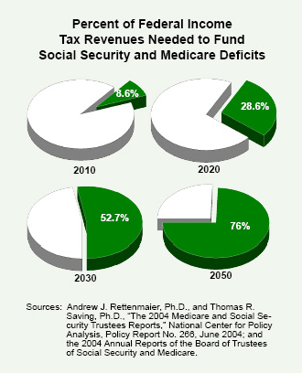

Slide 27
Corporate income taxes :
a tax placed on the money businesses earn
State sales taxes :
a tax place on the sale of goods and services ( 3% - 9%)
Local property taxes ( city and county)
* a tax based on the worth of a person’s property
* Ex: house and land
Citizens do not want to be annexed into the city because they do not want to pay city taxes.

Slide 28
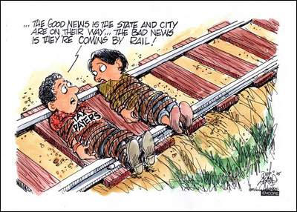
( $2,670 county tax on $500,000 house)
Tax Rates
TAXING UNIT 2010
WAKE COUNTY .534
$2,670. + $1,867.50 = $4,537.50
Recycling Fees
TAXING UNIT 2010
WAKE COUNTY $20.00
Properties not located within a municipality may be subject to a fire district tax and the RTP special district tax in addition to county taxes.

Slide 29
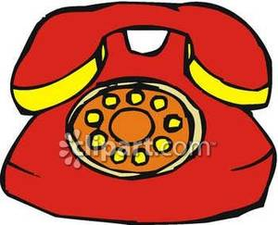
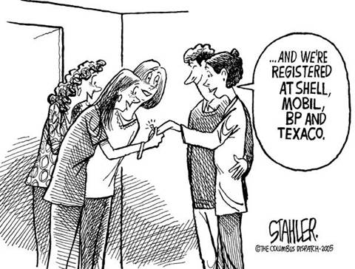
Excise taxes
tax on gasoline, tobacco, alcohol, legal betting, telephone service

Slide 30
Inheritance tax
estate tax
E. Other Revenue Sources:
1.fines
2.fees
3.government bonds
VEHICLE LICENSE TAX
The Vehicle License Tax increases from $25 to $30. It is estimated that the increase will result in an additional one million dollars of revenue over a 12 month period.
WATER & SEWER RATES
The Adopted Budget includes a nine percent rate increase for the City’s retail water and sewer rates which will be effective July 1, 2010. Under the adopted rates, the average residential customer who uses six CCF or 4,500 gallons a month will pay $39.81, an increase of $3.27 per month. Beginning November 1, 2010, increased tiered rates will also go into effect, which are anticipated to be revenue-neutral

Slide 31
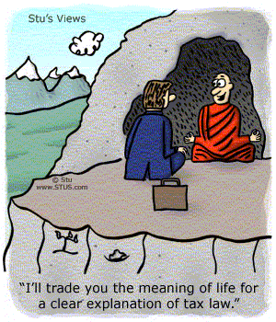
F. Personal economics: Personal budgeting
Paying your taxes/completing tax forms

Slide 32
Government’s Efforts to Solve Economic Problems
A. America’s Economic goals – no longer laissez-faire
Price Stability – inflation at 3% or less
Full employment

Slide 33
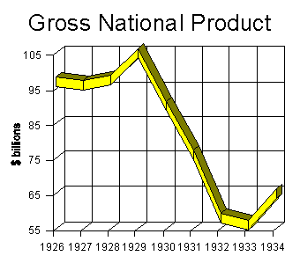
A condition in which anyone who wishes to work can. Usually set at 94 – 96% of the labor force, or 4 – 6% unemployment rate
Economic Growth – GDP rising at 3% per year. An increase in the economy’s capacity to produce goods and services
Economic opportunity – Everyone should have the same advantages of education and employment regardless of race, sex, religion or national origin.
Economic freedom – To make one’s own economic decisions in choosing an occupation, employer and how to spend money

Slide 34
Economic security – Protection from adverse events in one’s life (INSURANCE)
Economic efficiency – The process of producing the maximum amount and proper combination of goods and services from the nation’s limited productive resources

Slide 35
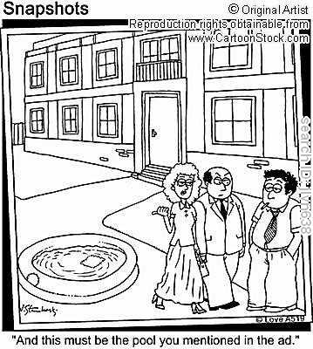
B. Economic Freedom – ensuing fair business practices
1.Controlling monopolies – Ensuring competition
Sherman Anti-trust Legislation: 1890-outlawed monopolies and trust-to vague = not enforceable
Clayton Anti-Trust Act : 1914 – easier to enforce
2. Banning false advertising
Outlawed “unfair or deceptive practices”
Truthful labels and honest advertisements

Slide 36
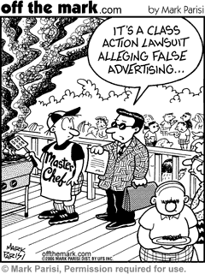
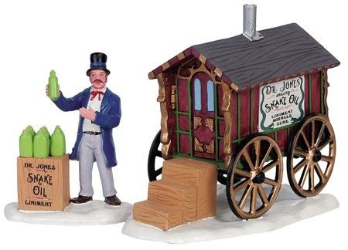
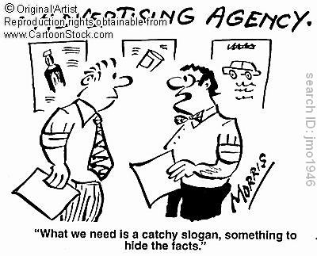

Slide 37
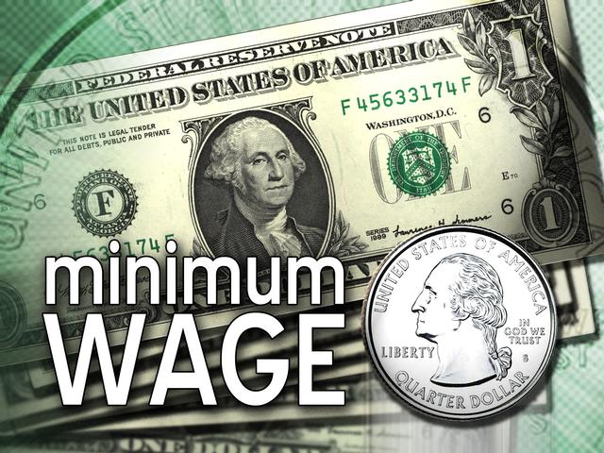
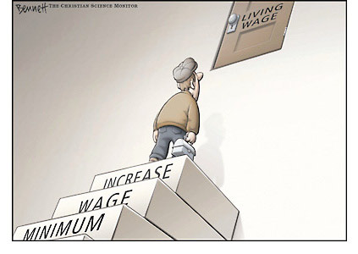
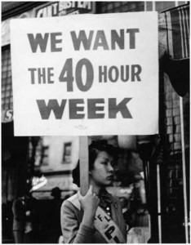
C. Economic Security – protecting the worker
1.National Labor Relations Act in 1935
Required employers to bargain with unions
Established the National Labor Relations Board
2.Fair Labor Standards Act in 1938
a. Minimum wage
b. Normal work week (40 hours) – overtime pay
c. Administered by the Labor Department
d. Child Labor laws – Put limit on age and number of hours
3

Slide 38
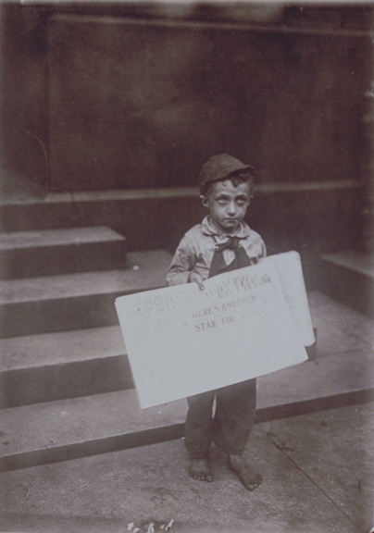
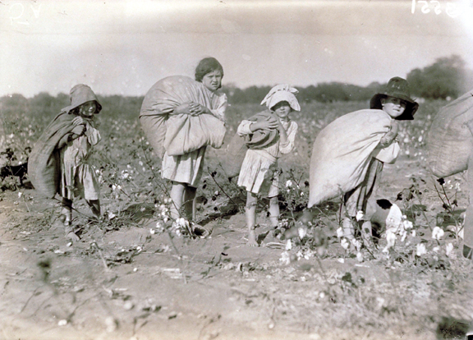
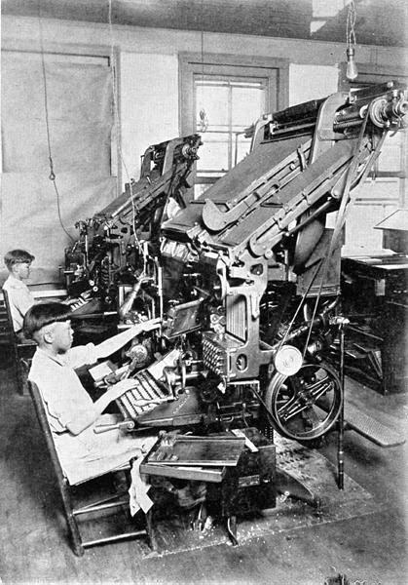
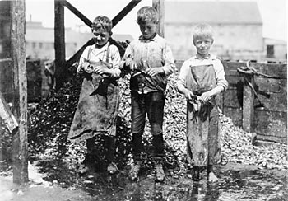

Slide 39
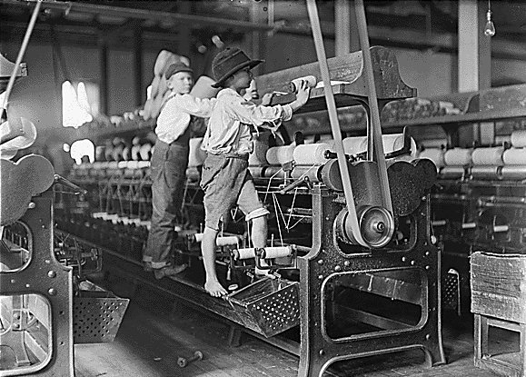
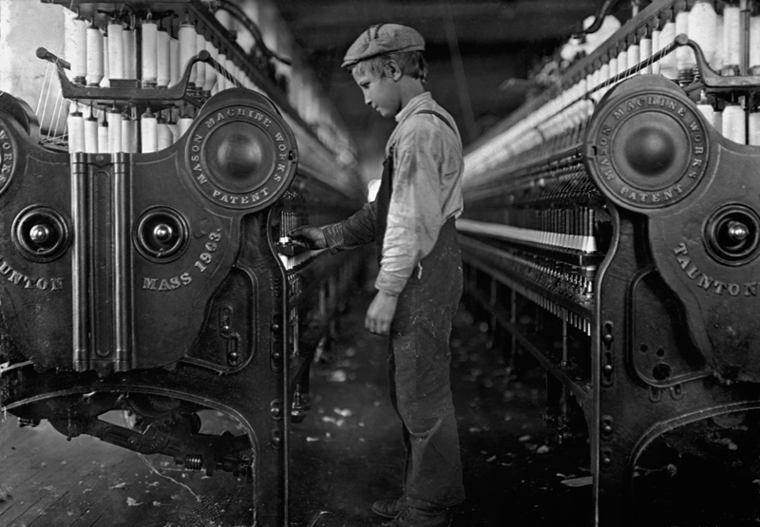
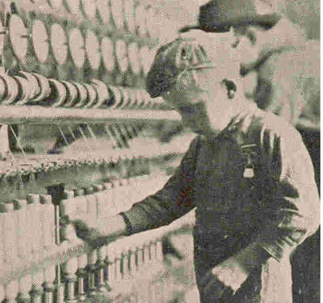

Slide 40
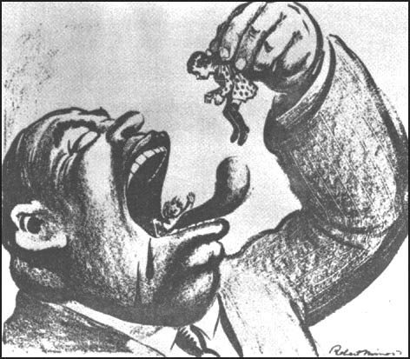

Slide 41
Age Minimums
Minors in North Carolina who are under 14 years of age may not be employed for non-agricultural occupations. There is permissible employment for minors even younger who are in stage, film, and television roles, but these are strictly regulated from production to production as to how much time the child can be on set and if a tutor should be present. Children working part-time or odd jobs like babysitting or doing minor chores around the house is also permissible. However, no one younger than 18 can work any type of job which is deemed a hazardous occupation.
Working Hours for 14- and 15-year-olds
Those 14- and 15-year-old workers who have been cleared to work through a work permit have very specific hours they can work each day. They can work no more than three hours on a school day, including Friday, and no more than 18 hours over the course of a week when school is in session. When school is not in session, they cannot work more than 40 hours a week. They must also be given a 30-minute break every five hours if under the age of 16.
Types of Jobs
Minors can be employed only in specific types of jobs. They can work most office and food service jobs, but they cannot work in processing, mining, or in any work room or work place where goods are being manufactured and processed. Minors may perform food preparation, but may not be involved in any baking or processing which involves the use of electric or gas grills or deep fat friers, both of which can injure them or those around them. Minors also cannot be involved in any work that involves transportation, warehousing, communication, or public utilities.

Slide 42
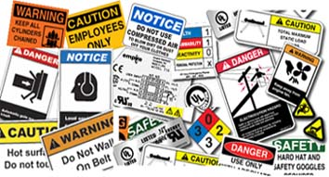
. Occupational Safety and Health Administration
Unsafe working conditions
Sets and enforces safety and health standards in the workplace

Slide 44
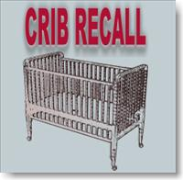
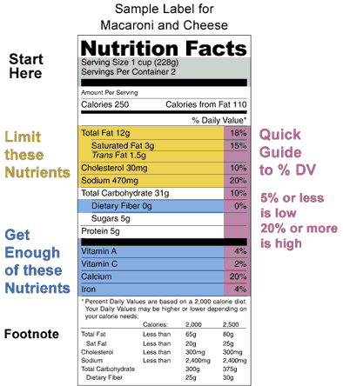
Protecting the Consumer from Unsafe Products
Food and Drug Administration (FDA) – sees that foods, cosmetics and drugs are safe and labeled correctly. It requires that new drugs be tested before they go on the market.
Consumer Product Safety Commission (CPSC) – sets safety standards
for products you might find around the house
Meat Inspection Act – Regulated the production of meat products

Slide 45
Protecting the environment
Environmental Protection Agency (EPA) – 1970
Controls pollution by making rules about what and how much can be dumped into our air, water, and soil

Slide 46
F. Protecting the elderly and the Poor
Social Security Act – Social Security Administration (1935)
Provides a monthly payment to workers or their families to replace income lost when a
person retires, becomes injured, or dies
2. Also provides unemployment insurance for workers who lose their jobs
Public assistance – local, sates and federal governments have expanded efforts to help people in need
3. Food stamp programs
4. Aid to families with dependent children

Slide 47
G. Economic Opportunity
1.Equal opportunity Act – Outlawed any type of discrimination in hiring based on race, sex,
religion and national origin established the Equal Employment Opportunity Commission (EEOC)
2. Monetary Policy – The actions taken by the federal reserve systems to control the
nation’s money supply and interest rates in order to achieve desired economic
objectives
3. Fiscal Policy – The deliberate use of the government’s spending and taxing powers
to influence economic activity in order to establish desired economic objective

Slide 48
Unit Five: Money, Banking, and Economic Policy
Money and Banking
What is the functions of money?
Money is anything widely accepted by society in exchange for goods and services
Medium of exchange ( businesses and people accept the currency)
Measure of value (allows people to know how much items are worth)
Store of value (holds its value)
European Union Countries
A map of the 27 (colored) EU countries (grey countries are candidate countries). About 493 million people live in the EU. Click for a larger version of the map. Source and illustration: europa.eu

Slide 50
Measure of Value (allows people to know how much items are worth)
1 Gallon of Milk = around $3
A Dozen White Large Eggs = $1.20 - $2.00
Multi/Whole Grain Bread = $2.50- $3.00
Hyperinflation in
POST WWI Germany
(1913) 5 paper marks = 1 dollar
(1920’s) 4,200,000,000,000 paper marks = $1 dollar.

Slide 51
Characteristics of Money
Durability – long lasting
Portability – light and easy to carry and transport
Acceptability
Divisibility – made in different values
Stability in value
U.S. paper $ and coins are no longer backed by gold or silver. Our paper $ could be exchanged for gold/silver until 1934. In 1963, Congress removed the right to exchange one-dollar bills for silver. In the late 1960’s, the silver in coins was removed and placed with copper and nickel.
This is the world's largest Gold Nugget ever found. Discovered in 1872 and is called the Holtermann Nugget. It was 630lbs in weight.
Drug Money Another internet favorite. $207 million is said to have been taken during a raid on a drug dealer's house in Mexico.

